Slide 1
Human Computer Interaction (HCI)
SAMIA ARSHAD

Slide 2

Human

Slide 3
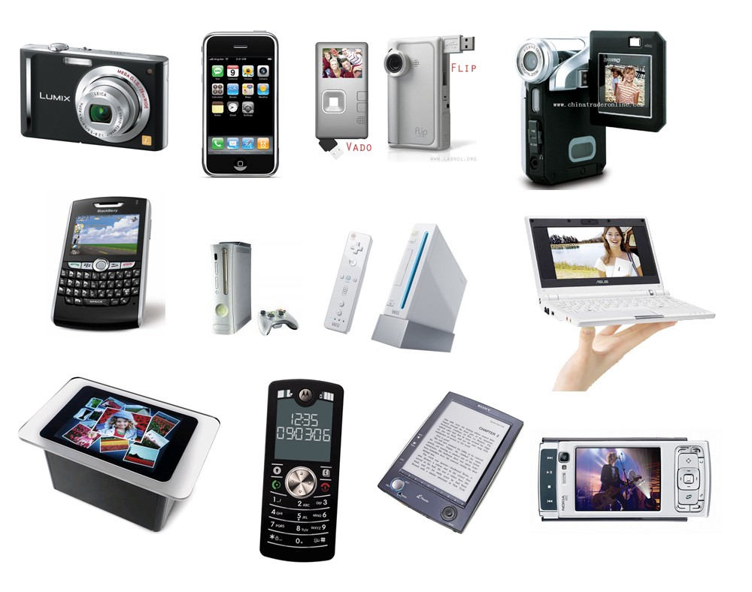
Computer
All electronic devices around us are computers

Slide 4
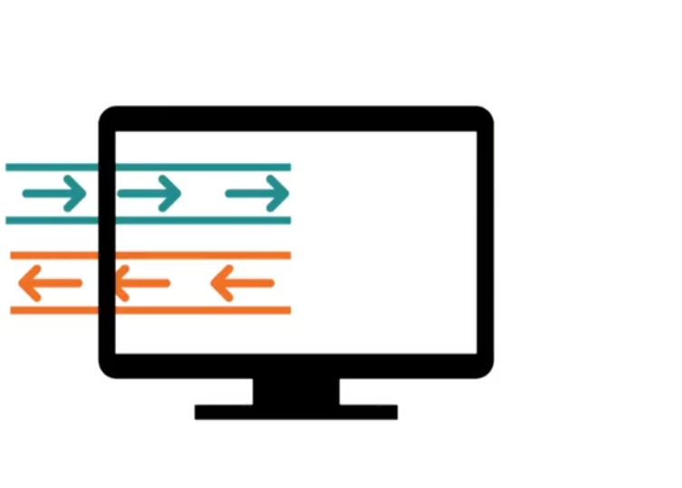

User Interaction
Human
Computer

Slide 5
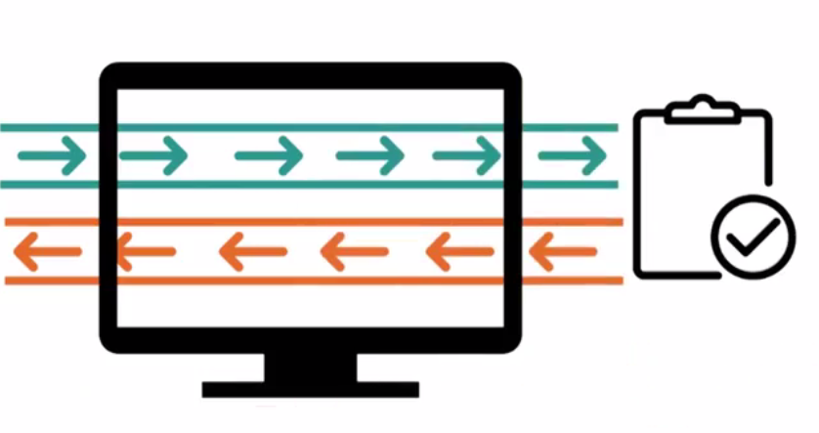
User Interaction
Human
Computer
Task

Slide 6
Good and poor design
A central concern of interaction design is to develop interactive products that are usable.
i.e. easy to learn, effective to use, and provide an enjoyable user experience.
Example: Well designed and poorly designed products
Remote Control

Slide 7
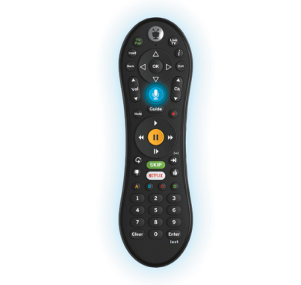
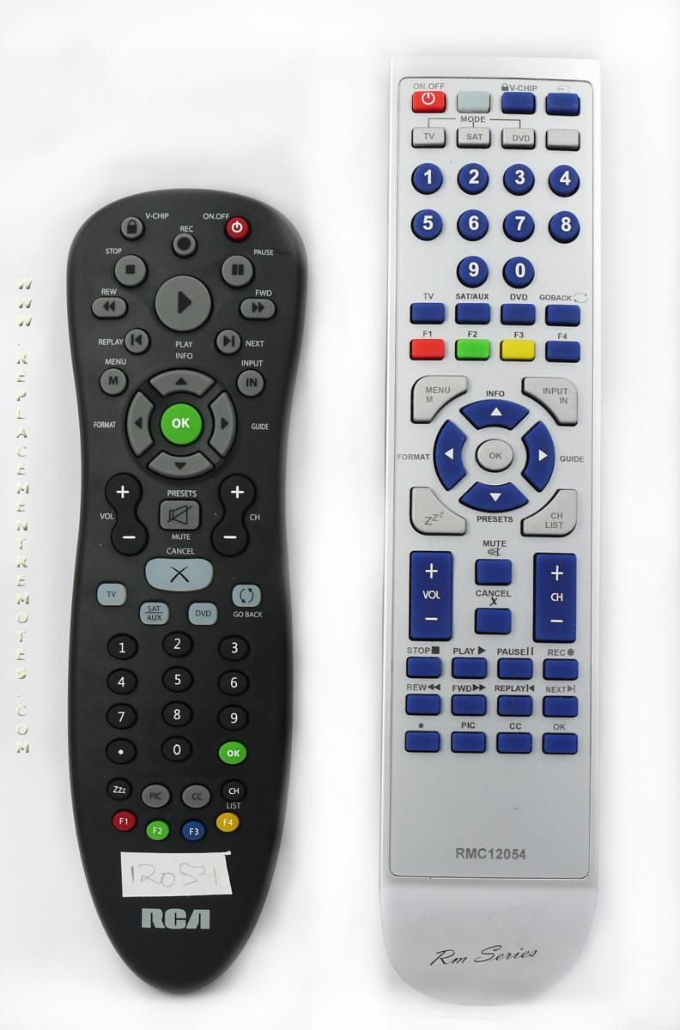
Solution Example

Slide 8
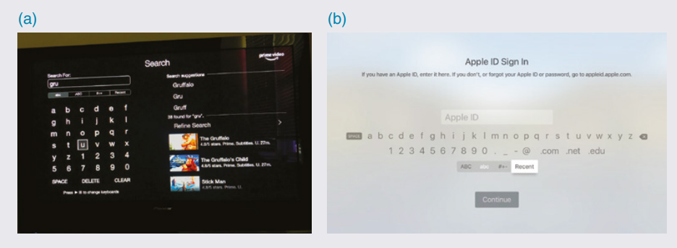
Smart Screens

Slide 9
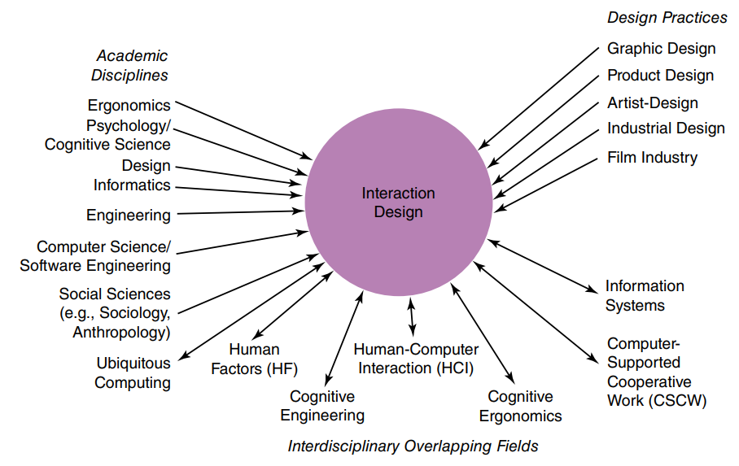
Interaction Design

Slide 10
Interaction design:
Designing interactive products to support the way people communicate and interact in their everyday and working lives

Slide 11
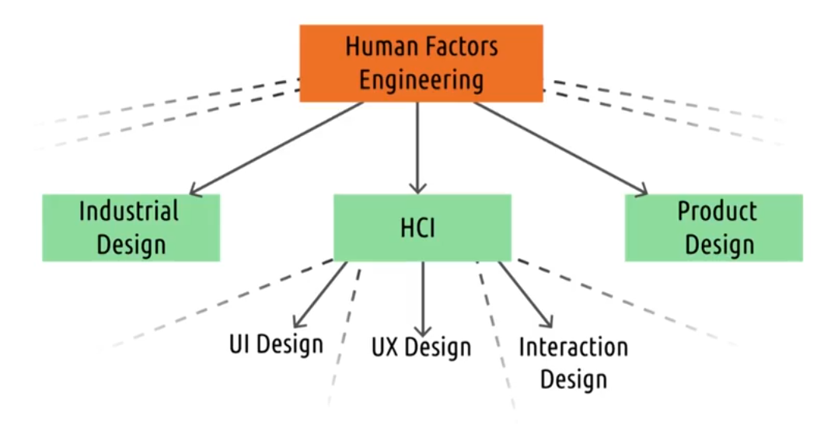
Human Computer Interaction(HCI)

Slide 12
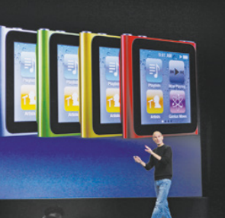
User Experience
The user experience refers to how a product behaves and is used by people in the real world.
It encompasses,
“all the aspects of the end user’s interaction with the company, its services, and its products.”
(Jakob Nielsen and Don Norman, 2014)
Don’t design user experience, but design FOR user experience.
Don Norman has stressed: It is not enough that we build products that function, that are understandable and usable, we also need to build joy and excitement, pleasure and fun, and yes, beauty to people’s lives.

Slide 13
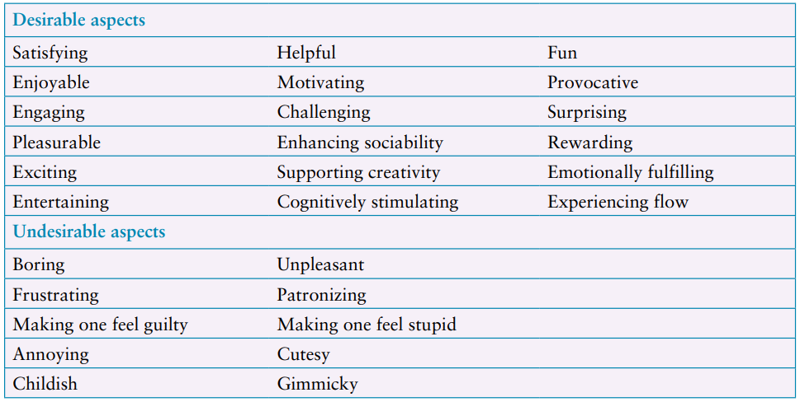
User Experience Goals
It also involves micro-interactions (small moments of interaction between user and design).

Slide 14
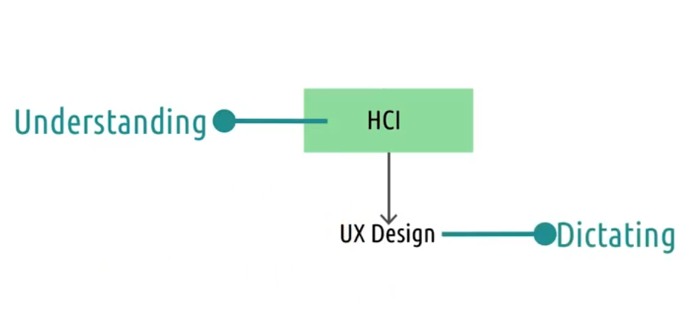
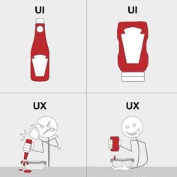
HCI and UX Design

Slide 15
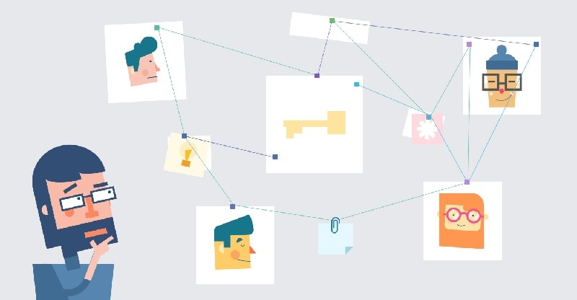
Understanding Users
Understand user in the context they live, work and learn to match user’s need.
e.g. Children and adults

Slide 16
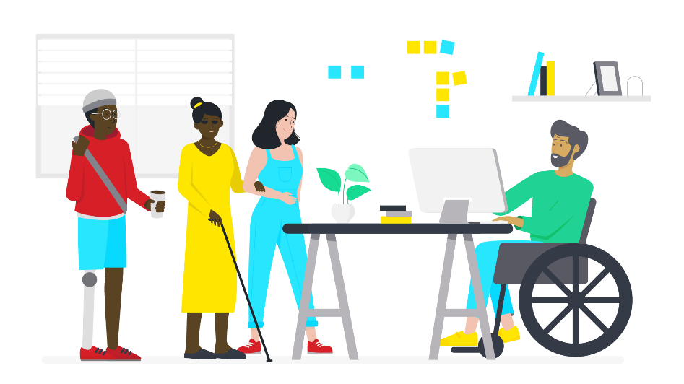
Accessibility and Inclusiveness
Extent to which an interactive product is accessible by as many as users possible, irrespective of impairments. Inclusiveness means being fair, open, and equal to everyone.
Can be achieved by
Inclusive design of technology
Design of assistive technology

Slide 17
Usability Goals
Effectiveness
Efficient
Safe
Utility
Learnability
Memorability

Slide 18
Usability Goals
Effectiveness
How good the product is at doing what it is supposed to do?
Efficient
Does product support user in carrying out task?
Safe
Protecting the user form dangerous conditions and undesirable situations.
preventing the user from making serious errors by reducing the risk of wrong keys/buttons being mistakenly activated.
Providing various means of recovery

Slide 19
Usability Goals
Utility
If the product provides right kind of functionality
Learnability
Is the system easy to learn
Memorability
How easy the product is to remember how to use, once learned.

Slide 20
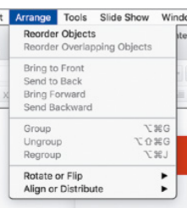
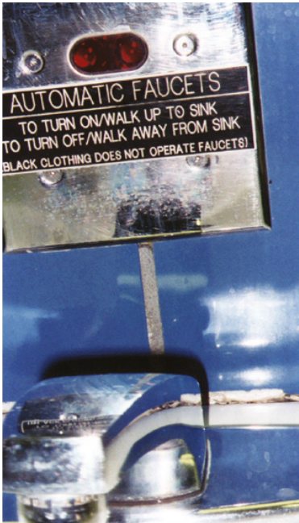
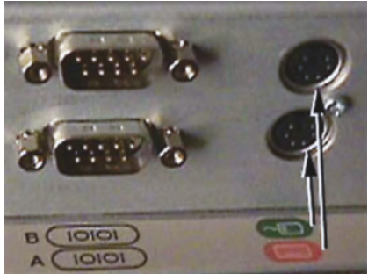
Design Principle
Visibility
Feedback
Constraints
Consistency
Affordances

Slide 21
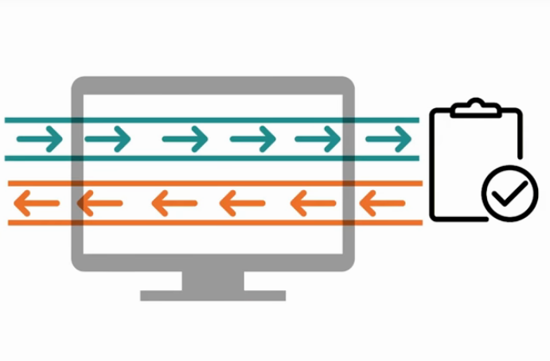
So Why Interaction is Important?
Human
Computer
Task

Slide 22
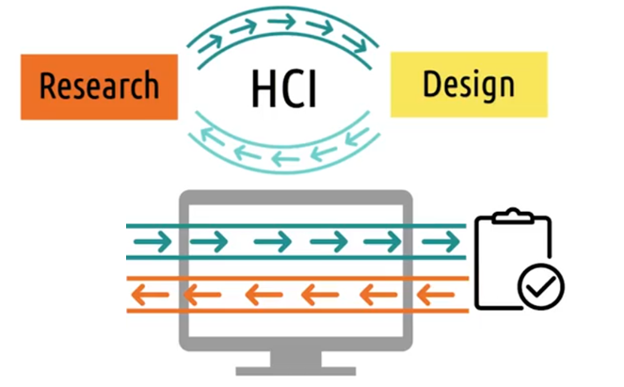
HCI: Research and Design

Slide 23
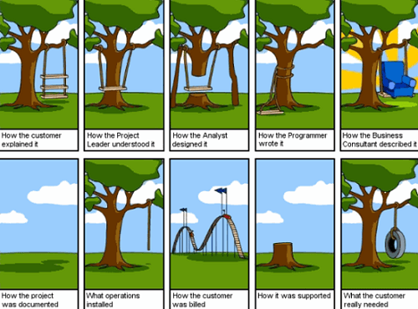
Conclusion
Human Computer Interaction
Interaction design
User Experience
Understanding Users
Accessibility and Inclusiveness
Usability and User Experience goals.

